Slide 1
Explainable AI
An introduction

Slide 2
Introduction

Slide 3
Explainable AI
large research area
much recent attention in the machine learning community
long history in AI research
much domain-specific work

Slide 4
Black box nature of many AI systems leads to lack of transparency
Makes it difficult to explain their decisions
Explainable AI (XAI) promotes AI algorithms that can show their internal process and explain how they make their decisions.
XAI aims to extract insights about how predictions have been performed or how the AI model operates for a set of inputs.
Deep learning has outperformed traditional ML approaches, however there is a lack of opacity/transparency

Slide 5
Reliance on AI decisions:
Product recommendations
Friend suggestions
News recommendation
Autonomous Vehicles in transportation
Financial decisions
Medical recommendations
…..

Slide 6
Regulations
GDPR
FDA on medical decisions/predictions
algorithmic accountability act 2019
many others

Slide 7
Trust and Adoption
Users need to understand why AI makes specific recommendations
If there is a lack of trust, then lower adoption etc.

Slide 8
Ethical Responsibility
Accountability for algorithmic decisions
Detecting and mitigating bias

Slide 9
Debugging & Improvement
Understanding failures (various types)
Model and algorithm enhancement
Detecting adversarial attacks.
Informing feature engineering and future data collection.

Slide 10
Many well known cases
COMPAS Recidivism Algorithm (2016): criminal risk assessment tool was biased against Black defendants
Amazon's Recruiting Tool (2018): discriminated against women. Trained on resumes mostly from men; learned a bias
Apple Card Credit Limits (2019): algorithm granted significantly lower credit limits to women compared to men with identical financial profiles
UK A-Level Algorithm (2020) system disproportionately downgraded students from disadvantaged backgrounds while favouring those from prestigious schools

Slide 11
XAI - evaluation

Slide 12
Evaluation of explanations ?
CCorrectness: How accurately the explanation represents the model's actual decision process
CComprehensibility: How understandable the explanation is to the target audience
EEfficiency: Computational and cognitive resources required to generate and process explanations

Slide 13
Evaluation of explanations ?
UUser-Centered Methods
sSimulated task experiments: do explanations improve user performance on specific tasks?
Effect on Trust : Assessing if explanations appropriately increase or decrease user trust based on model capabilities
Humans prefer simple explanations - causal structures etc., difficulty in capturing edge cases

Slide 14
Computational Evaluation Methods
Perturbation based changes
Identify top k features
Perturb the features (alter, delete, replace with random)
Plot prediction versus number of features perturbed
Usually the bigger the change following perturbation, the better the feature

Slide 15
Computational Evaluation Methods
Example-based explanation
Generation of an example to explain the prediction
Prototypes: Representative examples that illustrate typical cases
Counterfactuals: Examples showing how inputs could be minimally changed to get different outcomes
Influential instances: Training examples that has most influence
Boundary examples: Cases near the decision boundary that demonstrate model limitations

Slide 16
Computational Evaluation Methods
Example-based explanation - Evaluation metrics
PProximity (how close examples are to the original input)
DDiversity (variety of examples provided)
PPlausibility (whether examples seem realistic to users)

Slide 17
Saliency
Saliency methods highlight the input features or regions that most influence a model's prediction
GGradient-based methods: Calculate sensitivity of output with respect to input features
PPerturbation-based methods: Observe prediction changes when features are modified
AApplications:
IImage classification: Highlighting regions that influenced the classification
NNLP: Identifying influential words or phrases in text classification

Slide 18
XAI - approaches

Slide 19
XAI (Explainable AI)
Typically in AI systems we use data to give a recommendation, classification, prediction etc.
In XAI, we give the recommendation and an explanation and typically try to allow feedback.

Slide 20
XAI models:
Pre-modelling explainability
Interpretable models
Post model explainability

Slide 21
Pre-modelling explainability:
Data selection
Preparation transparency
Feature engineering (and documentation): why certain variables were selected
Design constraints documentation: Outlining constraints and considerations around
Success metrics definition: how the algorithm's performance will be measured beyond just technical accuracy

Slide 22
Explanation
Meaning behind a decision
Can be correct but complex (conjunction of many features)
Non-linear models – more difficult

Slide 23
Accuracy vs Explainability
Often as accuracy increases, explainability suffers
- linear models are relatively easy to explain
- NN and non-linear models - harder to explain
Usually a trade-off between the performance and explainability.
Much previous work has concentrated on improving performance and has largely ignored transparency
XAI – attempts to enable better model interpretability while maintaining performance

Slide 24
Accuracy vs Explainability
Some models are intrinsically explainable
Linear Regression
The effect of each feature is the weight of the feature times the feature value.
y = β0 + β1(x1) + . . . + βp(xp)

Slide 25
Accuracy vs Explainability
Intrinsic Models - Decision Trees
Tree based models split the data multiple times according to certain cutoff values in the features.
Decomposing the decision path into one component per feature. All the edges are connected by ‘AND’.
Can measure the importance of the feature by considering the information gain

Slide 26
Accuracy vs Explainability
Neural networks, connectionist, non-linear models
Much more difficult to generate explanations
Different approaches depending on what information you have access to
Neural networks:
https://playground.tensorflow.org/
Allows you to build NNS, change architecture, learning rules, data sets etc

Slide 27
Similarly, in reasoning systems, can generate explanations relatively easily.
Oftentimes, simple explanation concepts can be helpful - consider a complex MAS with learning - can be hard to explain dynamics; however, analysis of equilibria can give a reasonable explanation of likely outcomes

Slide 28
Basic learning approaches may give better understanding/explanations
If some function is learnable from a simple model, then use the simple model. Tends to lead to better explainability.
e.g. Could use a complex NN to learn a function; may be hard to derive an explanation.
However, we could perhaps learn the same function with a simple decision tree.

Slide 29
As we move to more complex models which are less interpretable, other approaches adopted
- feature importance
- dependence plots
- sensitivity analysis

Slide 30
Explanations for Neural Networks
Can be difficult to generate
Neural networks can be extremely sensitive to perturbations.
NNs susceptibility to adversarial attacks

Slide 31
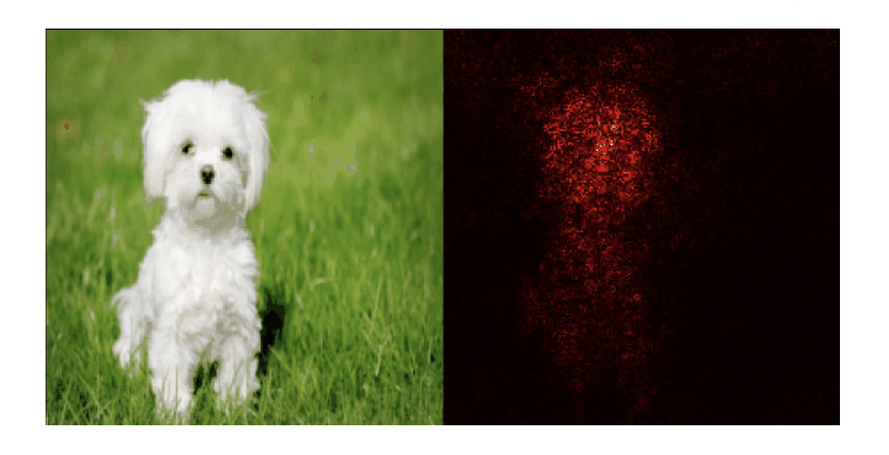
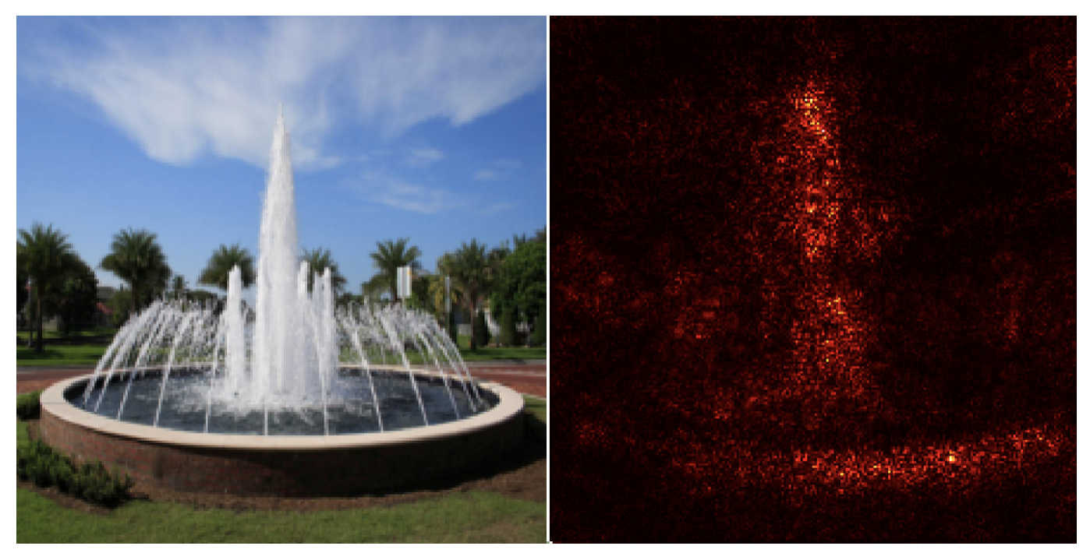
Saliency - examples
Ref: https://medium.datadriveninvestor.com/visualizing-neural-networks-using-saliency-maps-in-pytorch-289d8e244ab4
Ref: https://arxiv.org/pdf/1312.6034.pdf
Notes:
The quality from 1998 and 2014 is low because single gradient map is very faint (weak).
Deep models can have saturation problem.

Slide 32


Adversarial attack (an example)
Cat 87%
Dog 5%
ResNet-50
Starfish 3%
Clean image
Flower 2%
+
Apple 3%
Noise
Augmented by x100
Cat 2%
=
Dog 5%
ResNet-50
Starfish 2%
Adversarial image
Flower 88%
Apple 3%

Slide 33
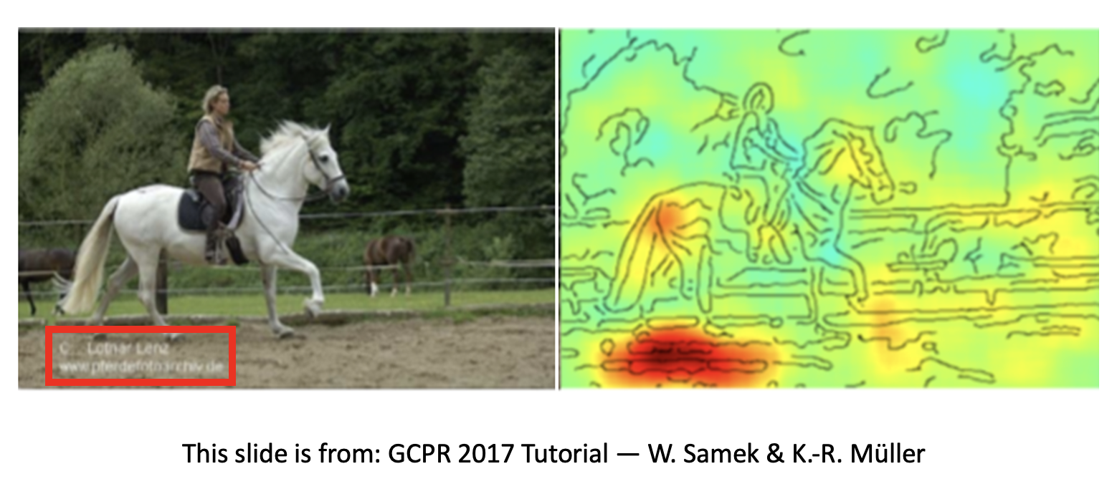
Example of explanation showing the failing of a NN
NN learn to pay attentions to the captions
Ref: The image comes from Hungyi Lee’s ML Lectures.

Slide 34
Explanations for Neural Networks
The predictions from NN must be aligned with humans and make sense to humans.
Approaches:
- Simplifying neural network
- Visualising
- Highlight aspects

Slide 35
The motivation of gradient based explainable approach
Large gradients for given inputs reflect the importance in activations.
The area with large gradients reflect the interested area by models.
Notes:
Retinal image with lesions/damages to algorithms,

Slide 36
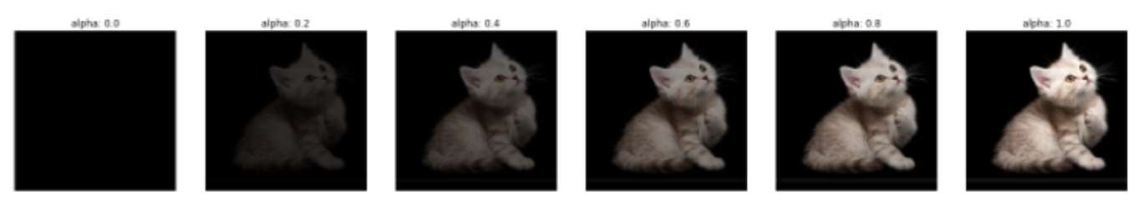
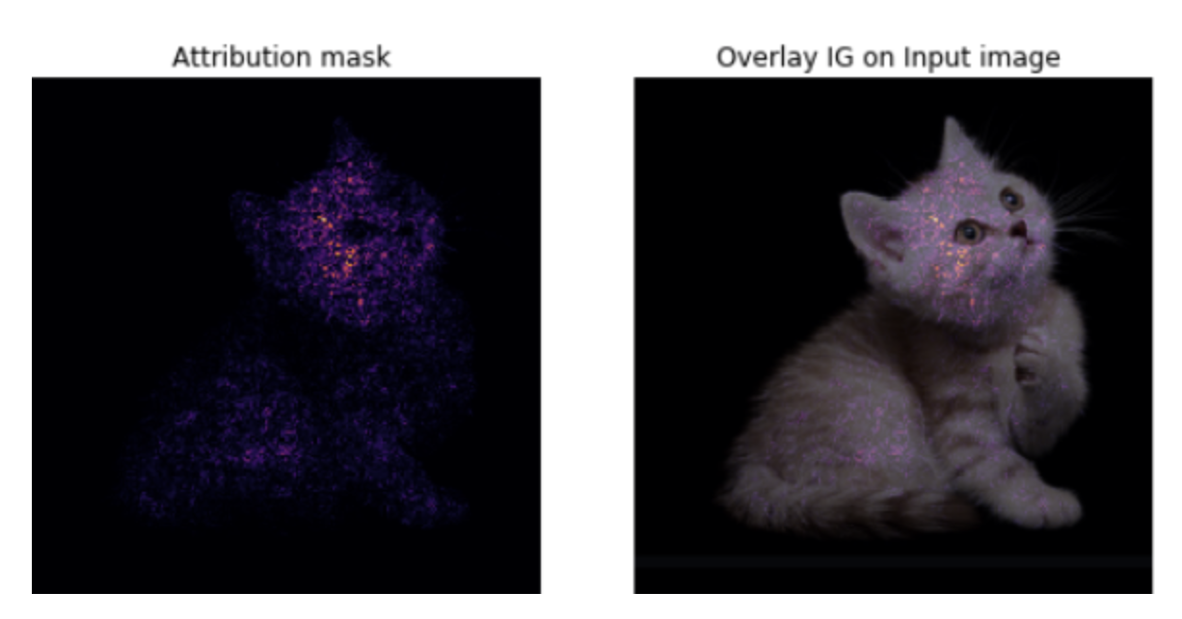
Integrated Gradients (2017)
Integrated Gradients
This work will first create multiple versions of the input image
Typically interpolate from blank image to actual image
The created multiple versions of the input will be fed into the models for computing gradients
The computed gradients will be added together to form the final gradient map.
Gives insight into which pixels lead to decision
Integrated gradients
Notes:
The quality from 1998 and 2014 is low because single gradient map is very faint (weak).
Deep models can have saturation problem.

Slide 37
Shapley Values
Stems from work in cooperative game theory
Each pixel is viewed as a "player" in a cooperative "game" where the "payout" is the model's prediction. Each pixel's average marginal contribution across all possible combinations of pixels.

Slide 38
Knowledge Graphs in Explanation
Knowledge graph - collection of facts or relations
Typically stored as SPO triples (subject, predicate, object)
Many large databases available
DBpedia - 4.6 million entities,
YAGO3 - 17M
Freebase - 40M
…..

Slide 39
Some manually curated - by experts, or by collaborative events
Others automated - scraped from collections (prone to noise)
Coverage is an issue - many attribute values missing

Slide 40
Can be used in learning to:
i) Augment input features with semantic information from knowledge graph
ii) In NNs, can augment intermediate features with knowledge
Can be used to support explanations - incorporate new knowledge
Can also generate explanations for different audiences

Slide 41
Summary
Receiving much attention in recent years
Much studied for a long time
Easier to generate explanations in simpler learning models
Issues regarding evaluation of explanations
Much work in neural networks in recent years

